Slide 1
صنعت تراشه‌های برنامه‌پذير

Slide 2
بازیگران اصلی صنعت
Altera -> Intel
Xilinx
Lattice
MicroSemi (Actel)
Cypress
Atmel

Slide 3
بازیگران اصلی صنعت
Altera + Xilinx
~ 70% - 80%
Wikiinvest.com
finance.yahoo.com

Slide 4
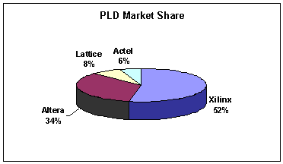
FPGA Market 2004

Slide 5
FPGA Market
September 2010:
Xilinx: 25%
Altera: 27%
Actel: 15%
Cypress: 12%
Atmel: 7%
Lattice: 4%
Quick Logic: 3%
http://finance.yahoo.com/

Slide 6
FPGA Market
January 2013:
Xilinx : 51%
Altera: 33%
Lattice: 11%
Microsemi (Actel) + others: 5%
http://www.wikinvest.com/stock/Altera_(ALTR)
http://www.wikinvest.com/wiki/Xilinx

Slide 7
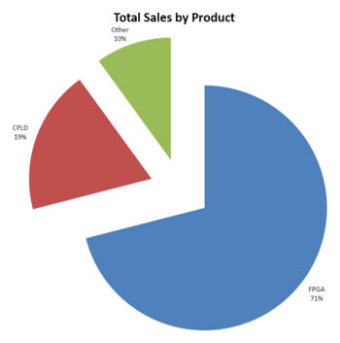
Altera PLD Products
[wikinvest.com], 2008
(2013: FPGA still 71%)
Other
10%
CPLD
19%
FPGA
71%
http://www.wikinvest.com/images/thumb/1/1f/ALTR_salesbyproduct.jpg/350px-ALTR_salesbyproduct.jpg
http://www.wikinvest.com/stock/Altera

